Slide 1
INTESTINAL YERSINIASIS and PSEUDOTUBERCULOSIS
Nosyreva Svetlana, assistant professor
of epidemiology and infectious diseases department

Slide 2
definition
Intestinal yersiniasis and pseudotuberculosis are acute zoonotic infectious diseases caused by Yersinia enterocolitica and Yersinia pseudotuberculosis.
The diseases may be characterized by general intoxication, exanthema, affection of gastrointestinal tract, joints, liver, lymphatic apparatus and other organs and tissues.

Slide 3
Etiology
Yersinia enterocolitica is:
pleomorphic,
gram-negative bacillus,
belongs to the family Enterobacteriaceae.
Yersinia can proliferate at refrigerated temperatures.
Y. enterocolitica is killed by direct sunlight, desiccation and disinfectants.
Both microorganisms die in boiling water in 10—30 seconds.
Y. enterocolitica is most frequently associated with:
enterocolitis,
acute diarrhea,
terminal ileitis,
mesenteric lymphadenitis,
pseudoappendicitis.

Slide 4
Etiology
Yersinia pseudotuberculosis, a gram-negative bacterial pathogen.
It primarily causes zoonotic infection in various hosts, including domestic animals and birds, but has been associated with food-borne infection in humans.

Slide 5
Epidemiology
Mechanism of transmission is fаecal-oral.
Y. enterocolitica is distributed widely throughout the world.
Сan be isolated from:
fresh water,
contaminated foods,
a wide range of wild and domestic animals.
Outbreaks have been associated with raw vegetables, рasteurized milk and dairy products.

Slide 6
Epidemiology
Тhe surface of vegetables can become contaminated with pathogenic microorganisms through contact with soil, irrigation water and animals.
Animal reservoirs of Y. enterocolitica include swine (principle reservoir), dogs, cats, cows, sheep, goats, rodents, foxes and birds.
Reports of person-to-person spread are conflicting and are generally not observed in large outbreaks.

Slide 7
Epidemiology
Pseudotuberculosis is wide-spread in nature.
Rodents are the most important source of infection.
There are epizootics among them frequently.
Besides, the cases of the disease occur among domestic animals (dogs, cats, great and small cattle).
Soil plays a leading part in preservation of Y. pseudotuberculosis as species.
The sick human is not a source of infection.

Slide 8
Epidemiology
The principal route of Pseudotuberculosis is oral.
The factors of transmission are:
food and water, contaminated by rodents.
Vegetables, used without thermal treatment, are the most important source in transmitting the pathogen.

Slide 9
Pathophysiology
The alimentary tract is the portal of entry in most cases of Intestinal yersiniasis.
As a foodborne pathogen, Y. enterocolitica can efficiently colonize and induce disease in the small intestine.
Following ingestion, the bacteria colonize the lumen and invade the epithelial lining of the small intestine, resulting in the colonization of the underlying lymphoid tissues (Peyer patches).
A direct lymphatic link between the Peyer patches and mesenteric lymph nodes may result in bacterial dissemination to these sites, resulting in mesenteric lymphadenitis or systemic infection.

Slide 10
Pathophysiology
Y. pseudotuberculosis infections in humans are primarily acquired through the gastrointestinal tract after consumption of contaminated food products.
The mucous membrane of intestinal tract is the portal of entry.
The primary inflammation focus occurs in:
the small bowel,
lymphatic system of the intestine,
lymph nodes.
Spreading of the pathogen and absorption of the toxins occurs from the local inflammation focus.

Slide 11
Pathogenesis
Pathogenesis of both diseases has many similar features.
Y. enterocolitica and Y. pseudotuberculosis are able to enter different tissue cells and multiply there. The latter feature is especially characteristic for Y. pseudotuberculosis.
Y. enterocolitica and Y. pseudotuberculosis
enter the human organism only through the mouth
development of pharyngitis and gastroduodenitis
the terminal ileum
caecum
in the first part of the ascending colon
regional lymph nodes

Slide 12
Pathogenesis
Y. enterocolitica and Y. pseudotuberculosis
invade epithelial cells and lymphatic apparatus of the intestine
translocate to the regional mesenteric lymph nodes
death of the affected cells
development of inflammatory changes
necrotic lesion in Peyer's patches
mucosal ulceration process in the intestinal mucosa
microabscesses in enlarged lymph nodes

Slide 13
Pathogenesis
Y. enterocolitica and Y. pseudotuberculosis
enter the blood-stream
with development of bacteraemia and hematogenous dissemination
with affection of different organs and tissues (liver, kidneys, lungs, lymph nodes, joints (enter the reticuloendothelial cells)
suppurative lesions may develop in different organs
After clinical recovery relapses may occur. Chronic infectious process may develop as well.

Slide 14
Intestinal yersiniasis Clinical features
The incubation period is 4-6 days, typically with a range of 1-14 days.
The major clinical syndromes
enterocolitis
mesenteric adenitis
terminal ileitis
septicemia
various immunoreactive conditions
Prodromal symptoms
malaise
headache
anorexia

Slide 15
Intestinal yersiniasis Clinical features
The usual presentation of Y. enterocolitica infection
diarrhea
low-grade fever
abdominal pain lasting 1-3 weeks
Diarrhea may be bloody in severe cases.
Vomiting is present in approximately 15-40% of cases.

Slide 16
Intestinal yersiniasis Clinical features
The existence of extraintestinal symptoms after a gastrointestinal illness may also indicate the possibility of yersiniosis.
Erythema nodosum may appear 2-20 days after the onset of fever and abdominal pain and manifesting as painful, raised red or purple lesions, mainly on the patient’s legs and trunk.
Y. enterocolitica septicemia is reported most commonly in patients who have predisposing conditions, including alcoholism, diabetes mellitus, or an underlying immune defect.
Reactive arthritis
Myocarditis
glomerulonephritis
Erythema nodosum

Slide 17
Differential diagnosis of Intestinal yersiniasis
amebiasis,
appendicitis,
Campylobacter infections,
Clostridium difficile colitis,
Crohn disease,
diverticulitis,
inflammatory bowel disease,
pseudotuberculosis,
salmonellosis.

Slide 18
Pseudotuberculosis Clinical features
The incubation period of the disease fluctuates from 3 to 18 days.
Clinical picture of the disease is polymorphic.
Usually the body temperature
rises from the first days of the disease,
fluctuates from subfebrile to febrile (39°–40 °C),
which has remittent or intermittent nature,
may be accompanied by febrile chill.
Duration of fever be sometimes longer.
There is headache, weakness, anorexia, insomnia.

Slide 19
Pseudotuberculosis Clinical features
Rash occurs in most of the patients and may appear in various terms (from the 2nd to 8th day of illness).
Rash characterized by:
polymorphism of its elements and various localization,
on reddened skin,
may be combined with macular, hemorrhagic, papular elements.
be localized on the lateral parts of the trunk, the internal and the back parts of legs, on the skin of the lower abdomen, in skin folds.

Slide 20
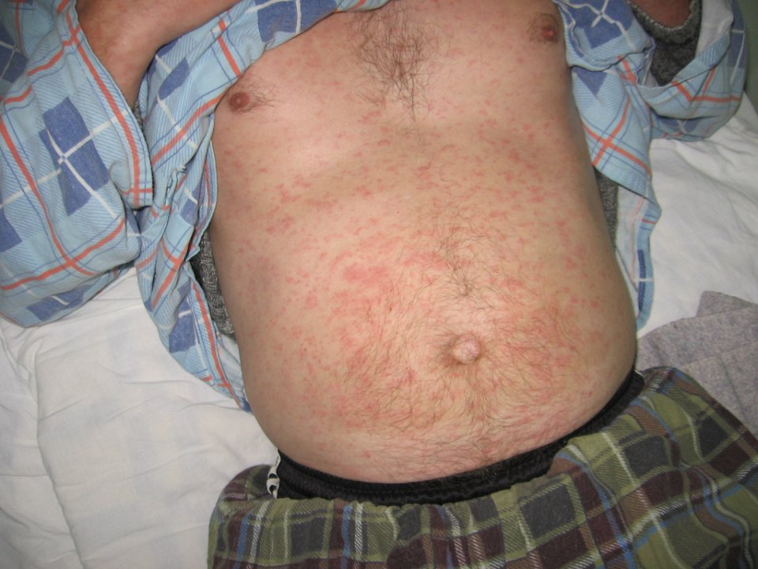
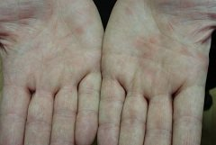
Rash

Slide 21
Pseudotuberculosis Clinical features
Besides, rash may appear on the external surfaces of arms and forearms, on the knee and radiocarpal joints.
Hyperemia and edema of skin on the face, hands and feet (symptoms of “hood”, “gloves” and “socks”) occur frequently.
Rash grows pale gradually during 1–5 days, more often on the 2nd–3rd day. Desquamation of skin on the hands and feet is observed in 30 % of the patients after disappearance of rash.
It usually occurs on the 5th–10th day after the onset of the disease.

Slide 22
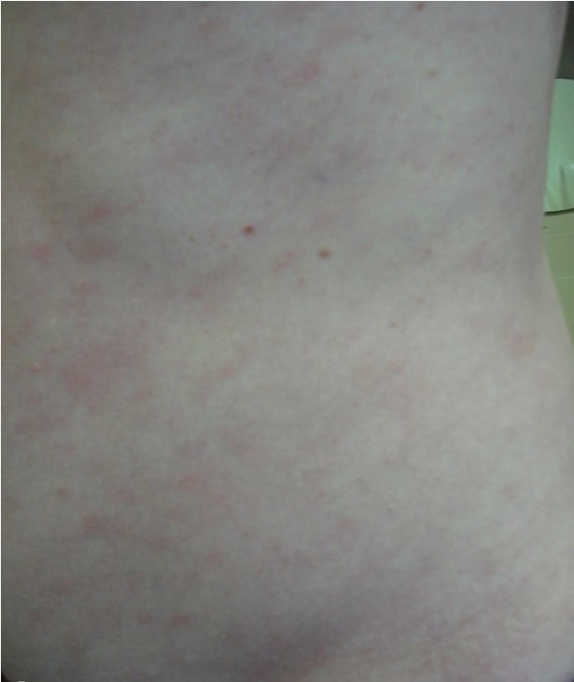
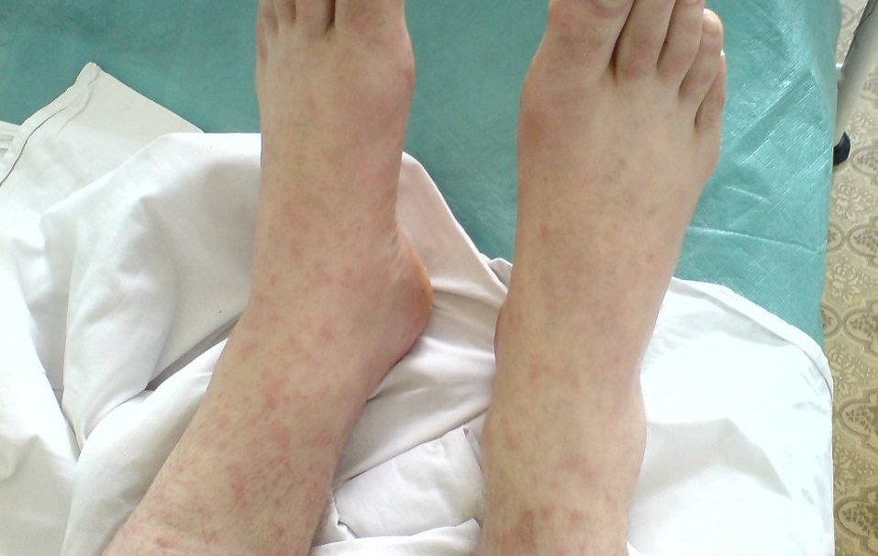
Rash

Slide 23
Pseudotuberculosis Clinical features
Changes in pharynx are found in most of patients.
They are characterized by:
hyperemia of palatal archs,
soft palate,
uvula,
back walls of pharynx.

Slide 24
Pseudotuberculosis Clinical features
Lesion of gastro-intestinal tract is observed in more than a half of patients in the form of :
gastritis,
gastroenteritis,
enteritis,
mesadenitis,
ileitis.

Slide 25
Pseudotuberculosis Clinical features
Clinically the lesion of gastrointestinal tract is manifested by:
nausea,
vomiting,
watery stool,
pains in epigastrium,
right hypochondrium, near the umbilicus, in the right iliac region.
Vomiting is usually single, inconstant.
Watery stool is 2–4 times a day, without pathological admixtures or with small admixture of mucus, its duration is from 1 to 3 days.

Slide 26
Pseudotuberculosis Clinical features
Affection of liver is observed in half of the patients and it is manifested by:
enlargement,
ictericity of skin and sclerae.
In blood serum there is an increasing of level of direct bilirubin, increasing of activity of transaminases, decreasing of prothrombin index.
Lesions of joints in pseudotuberculosis may develop in 50%–70% of patients.
There are mainly arthralgias, but sometimes there is clinics of polyarthritis; wrist, ankle and knee joints are most often involved in the process, shoulder and hip joints are more rarely involved.
Development of myocarditis and kidney lesions is possible.

Slide 27
Differential diagnosis of Pseudotuberculosis
appendicitis,
Clostridium difficile colitis,
other bacterial gastroenteritis,
Crohn disease,
leptospirosis,
acute pancreatitis,
sepsis,
typhoid fever,
ulcerative colitis.

Slide 28
Diagnosis
The clinical diagnosis of intestinal yersiniosis and pseudotuberculosis is often difficult because the symptoms of the diseases may resemble different infectious diseases.
The laboratory diagnosis
bacteriologically
recovery of Y. enterocolitica or Y. pseudotuberculosis from the faeces, CSF, blood or affected tissues

Slide 29
Diagnosis
Antigens of corresponding bacteria in blood and other biological fluids
Agglutinating antibodies in the blood
ELISA
RIHA
appear at the end of the first week of the disease but sometimes in 2—3 weeks after the onset of the disease
Paired serum specimens, taken at the end of the first week of the disease and 7—10 days after
In single tests of serum titers of antibodies 1:200 and higher are taken into account
Increase in level of serum antibody titre between two
The picture of peripheral blood shows leucocytosis with neutrophilic shift to the left. ESR may be increased.

Slide 30
Diagnosis
Laboratory confirmation of diagnosis can be:
isolation of the cultures Y. pseudotuber­culosis, Y. enterocolitica
detection of the bacterial DNA (PCR)
detection of antigens or antibodies to bacteria Ig A, M and G (ELISA)
increase in the antibody titer (RIHA).

Slide 31
Treatment of Intestinal yersiniasis
Enterocolitis caused by Y. enterocolitica is usually self-limited.
No antibiotic treatment in clinically stable cases may be indicated.
Diarrhea should be managed with fluid and electrolyte replacement.
Antimotility medications, which could lead to bacteremia, should be avoided.

Slide 32
Treatment of Intestinal yersiniasis
In cases of severe Y. enterocolitica enterocolitis, antibiotics have shown some benefit in terms of shortening the duration of illness.
Patient populations who should be considered for antibiotic therapy of intestinal yersiniosis include the following:
Severe clinical presentation
Elderly patients
Patients with diabetes
Patients with cirrhosis
Immunocompromised patients
Patients with cancer who are receiving chemotherapy
Healthcare and childcare workers who are at an increased risk of person-to-person spread.

Slide 33
Treatment of Intestinal yersiniasis
In the above-named cases following antibiotic regimens are possible:
ciprofloxacin 500 mg per os twice daily;
combination of doxycycline 100 mg intravenous twice daily and gentamicin 5 mg/kg intravenous every 24 hours.
Resistance of Y. enterocolitica to ampicillin is often seen today, so it is not the best antibiotic to prescribe in such cases.
Pathogenetic and symptomatic therapies are necessary.

Slide 34
Treatment of Pseudotuberculosis
Clinically ill patients and septicemia patients may receive one of the possible regimens:
Ciprofloxacin 500 mg per os twice daily;
Doxycycline 100 mg intravenous twice daily;
Gentamicin 5 mg/kg intravenous every 24 hours.
Duration of antibiotic therapy course is no less than 7 days, and in complicated and severe cases duration of the course is continued up to 10–14 days.
Because of the resistance of Y. pseudotuberculosis to ampicillin and its greater prevalence, this agent would not be a good choice for empiric therapy in a clinical situation where this organism could be present.

Slide 35
Prevention
There is no specific prevention.
Proper sanitary surveillance for food processing, food handlers and food service must be performed.
In particular prevention of intestinal yersiniosis and pseudotuberculosis includes the following measures:
preventing food-stuffs from faecal and urine contamination by rodents and other animals;
pest control and extermination of rodents;
not using food containing uncooked meat;
washing vegetables and fruits before eating.

Slide 36
Anti-epidemic measures in an epidemic focus of the diseases
Measure | Content
Measures directed to the source of infection
Sanitary and veterinary measures | Inspection of farms, dairies. Revealing in­fected animals, its isolation and treatment. Estimation of the number of rodents, search for the fresh damages on vegetables produced by rodents, excrements or dwell­ing burrows of rodents in buildings (refrigerating chambers, the food warehouses of dry and bakery products, vegetable stores).
Diratization | Rodent control

Slide 37
Anti-epidemic measures in an epidemic focus of the diseases
Measures directec to the infected persons
Registration and notification | Routine procedure.
Isolation | Hospitalization is performed according to clinical indications.
Diagnostics | Laboratory confirmation of diagnosis can be: • isolation of the cultures Y. pseudotuber­culosis, Y. enterocolitica • detection of the bacterial DNA • detection of antibodies to bacteria Ig A, M and G • increase in the antibody titer.
Treatment | Patients are treated according to the exami­nation and treatment standards for infec­tious and parasitic diseases till the moment of the clinical recovery.

Slide 38
Anti-epidemic measures in an epidemic focus of the diseases
Discharging from hospital. Admission to educational set­tings or work. | -after a complete clinical recovery, usually without a control laboratory examination. Admission is possible after clinical recovery.
Dispanserization | Duration 1 month in non-complicated forms; at least 3 months in prolonged forms of the disease.
Measures interrupting the mechanisms of transmission
Current disinfec­tion | Objects: the dishes, kitchen utensils, dif­ferent surfaces in rooms, warehouses, food processing enterprises etc.
Final disinfec­tion | Not regulated.

Slide 39
Anti-epidemic measures in an epidemic focus of the diseases
Measures directed to persons contacted a source of infection
Revealing and laboratory inves­tigation | We reveal persons who have been exposed to the same conditions of risk to be infect­ed.
Clinical check­up | It includes an evaluation of the health state and taking temperature as well.
Medical observa­tion | It lasts 18 days.
Post-exposure prophylaxis | Not regulated.
Hygienic educa­tion | Physicians are still discussing on the clini­cal signs and prevention of infection.

